Slide 1
P19 & Risk Appetite
Strategic Risk Corporate Area | Boadilla del Monte, 06/07/16

Slide 2

Agenda
CEO Letter to CountryHeads and Process Overview
1
Information Requirements
2
Formal Assessment on P19 & RAS consistency
3
Next Steps
4

Slide 3
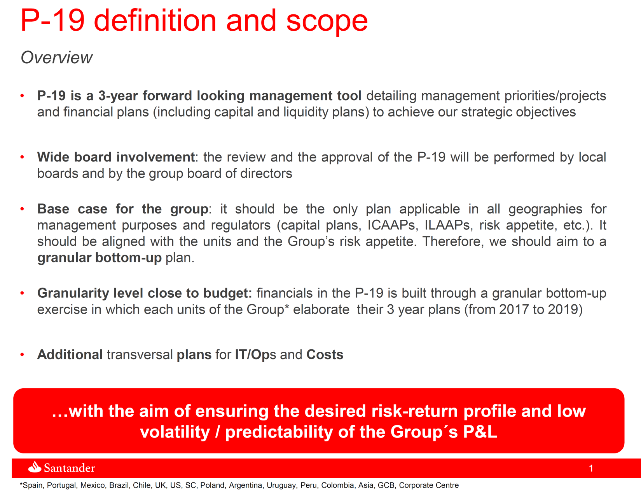
1
Letter to Country Heads

Slide 4
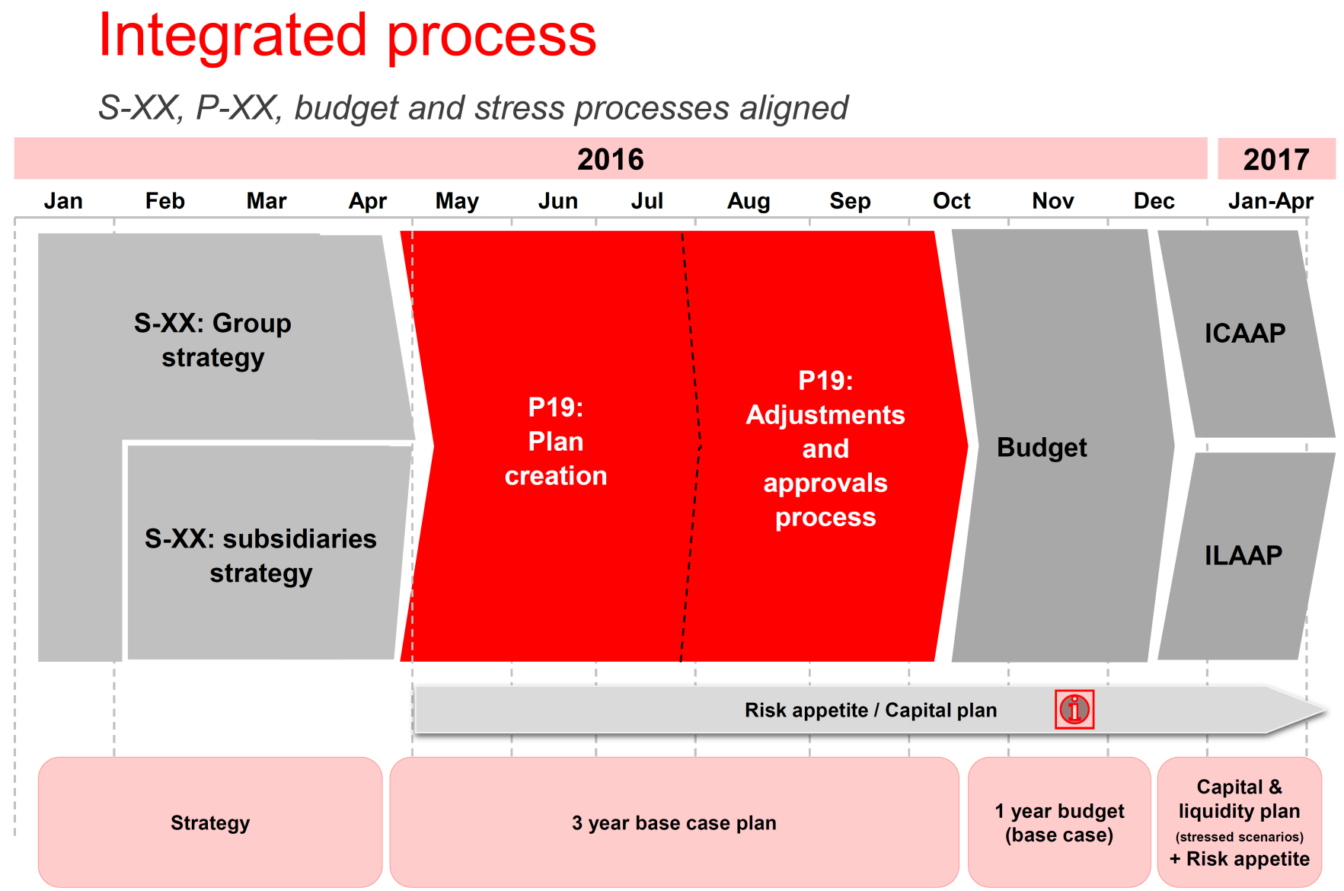
1
Process Overview
Initial assessment
11th July
Final assessment
12th September
Annual RAS setting

Slide 5
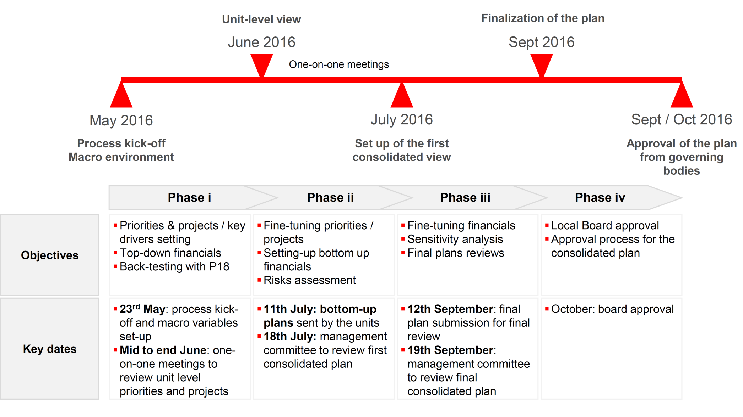
1
Process Overview

Slide 6
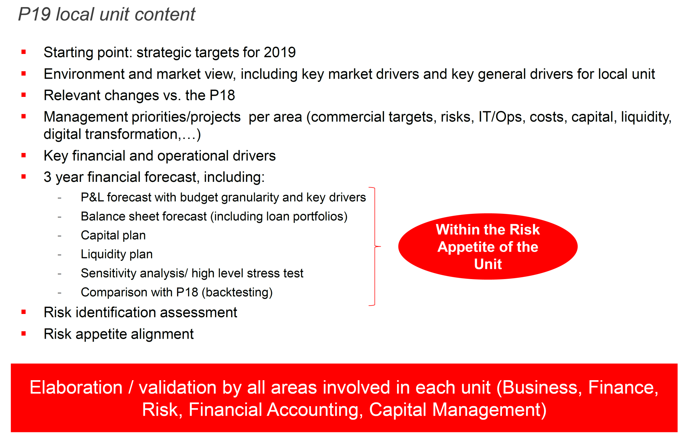
1
Process Overview

Slide 7
Agenda
CEO Letter to CountryHeads and Process Overview
1
Information Requirements
2
Formal Assessment on P19 & RAS consistency
3
Next Steps
4

Slide 8
Petición Control de Gestión
8
8

Slide 9
Petición Control de Gestión
9
9

Slide 10
Agenda
CEO Letter to CountryHeads and Process Overview
1
Information Requirements
2
Formal Assessment on P19 & RAS consistency
3
Next Steps
4

Slide 11
P-19: Key risks and risk appetite alignment
[●]
Key P-19 Risks
[●]
P19 alignment with risk appetite
11
11

Slide 12
P19 vs. Apetito de Riesgo (1/4)
Métricas |  | Apetito en Vigor (Límite y Alerta) |  |  | Valores proyectados |  |  |  |  |  | Encaje y coherencia P19 – Apetito de Riesgos
 |  | Limite | Alerta | Actual | Dic 2016 | 2017 | 2018 | 2019 | 3 años RAV
 | Pérdidas
1 | Pérdidas adicionales en estrés / BAI proyectado
3 | Coste de crédito (provisión anual en cuenta PyG / inversión crediticia media)
4 | Pérdidas de riesgo operacional / margen bruto

Slide 13
P19 vs. Apetito de Riesgo (2/4)
Métricas |  | Apetito en Vigor (Límite y Alerta) |  |  | Valores proyectados |  |  |  |  |  | Encaje y coherencia P19 – Apetito de Riesgos
 |  | Limite | Alerta | Actual | Dic 2016 | 2017 | 2018 | 2019 | 3 años RAV
 | II. Solvencia
5 | Ratio CET1 (fully loaded), escenario base
6 | Ratio CET1 (fully loaded), en estrés
7 | Ratio de Capital Total (phase-in)
8 | Ratio de apalancamiento, en condiciones normales
9 | Ratio de apalancamiento, en estrés

Slide 14
P19 vs. Apetito de Riesgo (3/4)
Métricas |  | Apetito en Vigor (Límite y Alerta) |  |  | Valores proyectados |  |  |  |  |  | Encaje y coherencia P19 – Apetito de Riesgos
 |  | Limite | Alerta | Actual | Dic 2016 | 2017 | 2018 | 2019 | 3 años RAV
 | III. Liquidez
11 | Ratio Financiación Estructural
12 | Ratio de Cobertura de Liquidez (LCR)

Slide 15
P19 vs. Apetito de Riesgo (4/4)
Métricas |  | Apetito en Vigor (Límite y Alerta) |  |  |  | Encaje y coherencia (cualitativos) P19 – Apetito de Riesgos
 |  | Limit | Alert | Current
 | IV. Concentración / Concentration
14 | Corporates - Máxima exposición individual, (expresada en términos de % sobre FFPP)
15 | Corporates - Máxima concentración en Top 20, (expresada en términos de % sobre FFPP)
16 | Instituciones Financieras - Máxima exposición individual, (expresada en términos de % sobre FFPP)
17 | Instituciones Financieras - Máxima concentración en Top 20, (% sobre FFPP)
18 | Concentración sectorial - Máxima exposición a un sector, (en % sobre total exposción crediticia)
19 | Máxima exposición a Commercial Real Estate, (en % sobre total exposción crediticia)
20 | Máxima exposición en carteras de alto riesgo, (en % sobre total exposción crediticia)
21 | Máxima exposición en carteras relevantes*, (en % sobre total exposción crediticia)
 | * Carteras relevantes: carteras que por su perfil de riesgo y materialidad tienen un límite específico en apetito de riesgo (ej. cartera de hipotecas en francos suizos en Polonia, Multifamily en EE.UU., etc)

Slide 16
P19 vs. risk appetite (1/4)
Metrics |  | Current Appetite (Limit & Alert) |  |  | Metrics forecast |  |  |  |  |  | Consistency P19 - Risk Appetite
 |  | Limit | Alert | Current | Dec 2016 | 2017 | 2018 | 2019 | 3yrs RAG
 | I. Losses
1 | Additional losses in stress / projected PBT
3 | Cost of credit (P&L provisions for the year / average outstandings)
4 | Operational risk losses / gross margin

Slide 17
P19 vs. risk appetite (2/4)
Metrics |  | Current Appetite (Limit & Alert) |  |  | Metrics forecast |  |  |  |  |  | Consistency P19 - Risk Appetite
 |  | Limit | Alert | Current | Dec 2016 | 2017 | 2018 | 2019 | 3yrs RAG
 | II. Solvency
5 | CET1 ratio (fully loaded), baseline scenario
6 | CET1 ratio (fully loaded), under stressed scenario
7 | Total Capital Ratio (phase-in, transitional)
8 | Leverage ratio, baseline scenario
9 | Leverage ratio, under stressed scenario

Slide 18
P19 vs. risk appetite (3/4)
Metrics |  | Current Appetite (Limit & Alert) |  |  | Metrics forecast |  |  |  |  |  | Consistency P19 - Risk Appetite
 |  | Limit | Alert | Current | Dec 2016 | 2017 | 2018 | 2019 | 3yrs RAG
 | III. Liquidity
11 | Structural Funding Ratio
12 | LCR, Liquidity Coverage Ratio

Slide 19
P19 vs. risk appetite (4/4)
Métricas / Metrics |  | Current Appetite (Limit & Alert) |  |  |  | Consistency P19 - Risk Appetite (qualitative)
 |  | Limit | Alert | Current
 | IV. Concentración / Concentration
14 | Corporates - Single name maximum exposure (expressed in relative terms, as % of equity)
15 | Corporates - Top 20 maximum concentration (expressed in relative terms, as % of equity)
16 | Financial Institutions - Single name maximum exposure (expressed in relative terms, as % of equity)
17 | Financial Institutions - Top 20 maximum concentration (expressed in relative terms, as % of equity)
18 | Industry concentration - Maximum exposure to a single industry (as % of total credit exposure)
19 | Maximum exposure to Commercial Real Estate (as % of total credit exposure)
20 | Maximum exposure to high risk portfolios (as % of total credit exposure)
21 | Maximum exposure to relevant portfolios* (as % of total credit exposure)
 | * Relevant portfolios: portfolios that because of their risk profile and materiality have specific limits under risk appetite (eg. CHF mortgage porfolio in Poland, Multifamily in US, etc)

Slide 20
Annex - Expert assessment on RA losses stress
 |  |  | P-19 |  |  | Vs P-18
 |  | 2017 | 2018 | 2019 |  | 2017 | 2018
 | GDP (%) | 3,1 | 3,2 | 2,6 |  | + 0,3 pp | +0,1 pp
 | Unemployment (%) | 5,2 | 5,0 | 4,8 |  | -0,2pp | -0,3pp
 | Pre provision profit | 3.2 | 3.6 | 4.0 |  | +5% | +3%
 | Net credit losses | -0.7 | -0,6 | -0.6 |  | -2% | -3%
 | Profit before taxes | 2.2 | 2.8 | 3.3 |  | + 7% | + 9%
Macro
Key takeaways on macro evolution and its impact on RA stress metric
Financial
Plan
Key takeaways on the financial plan and its impact on RA stress metric
 | P-18 vs P-17
Margins | More focus on fees
Credit | Tightened underwriting criteria.
Trading portfolio | Estable risk profile.
Operational risk | Reinforced proccesses
Risk Profile
Key takeaways on risk profile evolution and its impact on RA stress metric
Losses Stress & Volatility
 |  | P-19 (proxy) |  |  |  | P-17
 |  | 2016 | 2017 | 2018 |  | 2016 | 2017
 | Δ Margins (stress vs base) | -19% | -30% | -25% |  | -30% | -25%
 | Δ Credit (stress vs base) | +20% | +37% | +20% |  | +37% | +20%
 | Δ Trading (stress vs base) | -10% | -10% | -10% |  | -10% | -10%
 | Δ Operat. (stress vs base) | +50% | +50% | +50% |  | +50% | +50%
 | Δ Stress losses / PBT | < 85% | < 70% | < 70% |  | 85% | 65%
Assessment on expected P18 compliance with the RA stress metric
20

Slide 21
Agenda
CEO Letter to CountryHeads and Process Overview
1
Information Requirements
2
Formal Assessment on P19 & RAS consistency
3
Next Steps
4

Slide 22
Next Steps
Preliminary reviews (units teams with corporate teams) on one-to-one sessions
Submission by units of P19 – RA assessments: by 11th July
Feedback before final presentation to the Management Committe (18th July)
22
22

